Slide 1
Analysis of 2016-17 NHL Player Data
Chris Benzen
Chris Gargano
Jack Weiland

Slide 2
AGENDA
Project Description
Hockey 101
Data Collection & Validation
Data Analysis
Results

Slide 3
PROJECT DESCRIPTION

Slide 4
PROJECTION DESCRIPTION
Using a data set for the 2016-17 NHL Season, we will compare analyze a variety of different measures to identify interesting trends and unique data relationships.
We will have a particular focus on player salaries, and whether higher paid players are really worth their salaries.

Slide 5
HOCKEY 101

Slide 6
GENERAL OVERVIEW
Each team has 5 skaters on the ice and 1 goalie
Game lasts 60 minutes. Broken into three 20 minute “Periods”
The objective of the game is to put the puck into the opposing teams goal. This is defined as a “goal”
Winner is decided by the team with the most goals

Slide 7
PLAYER STATS

Slide 8
Goals = Player to put, “score”, the puck into the goal
Assists = Player(s) who touched the puck, in any way, to help the goal scorer
Points = Goals + Assists

Slide 9
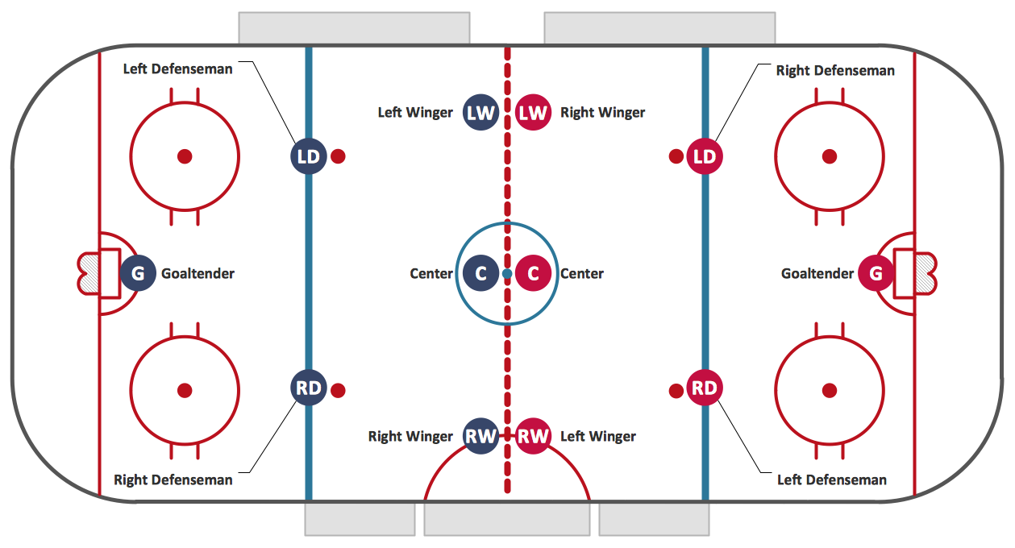
ALL POSITIONS

Slide 10
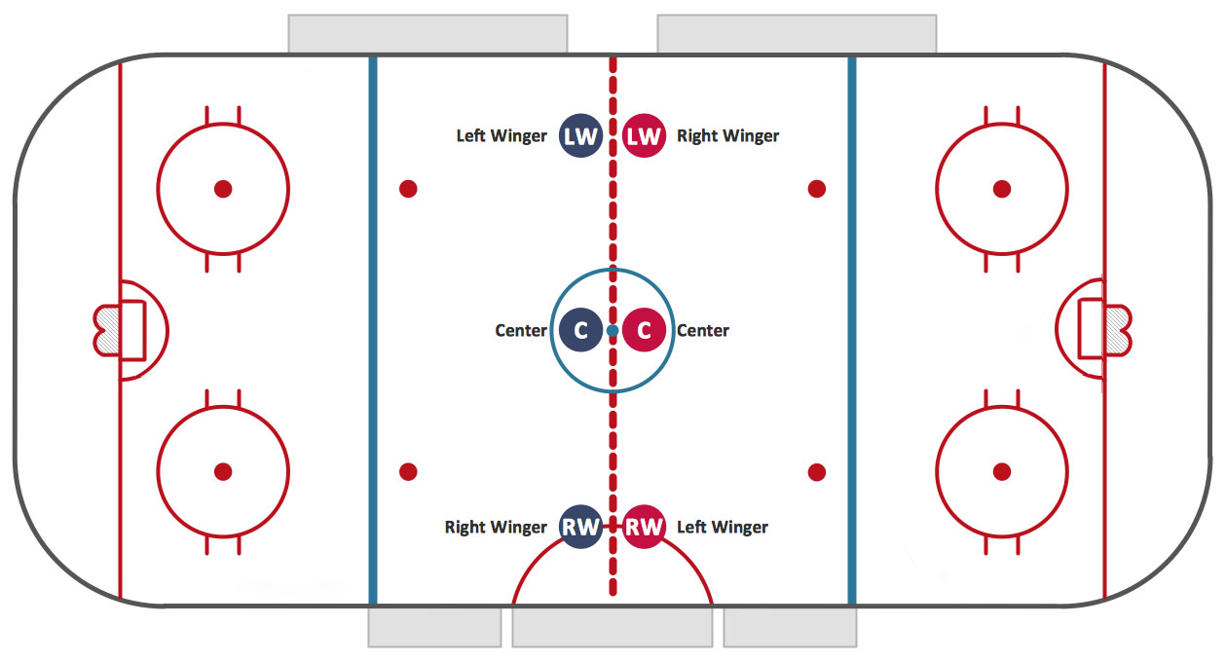
FORWARDS

Slide 11
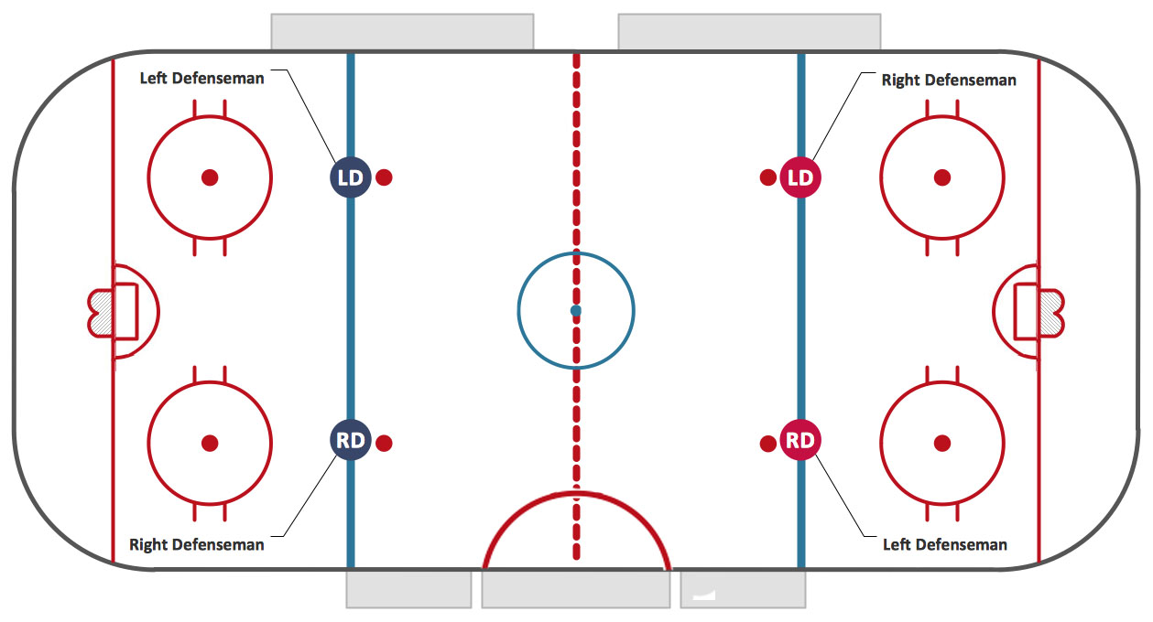
DEFENDERS

Slide 12
DATA COLLECTION & VALIDATION

Slide 13
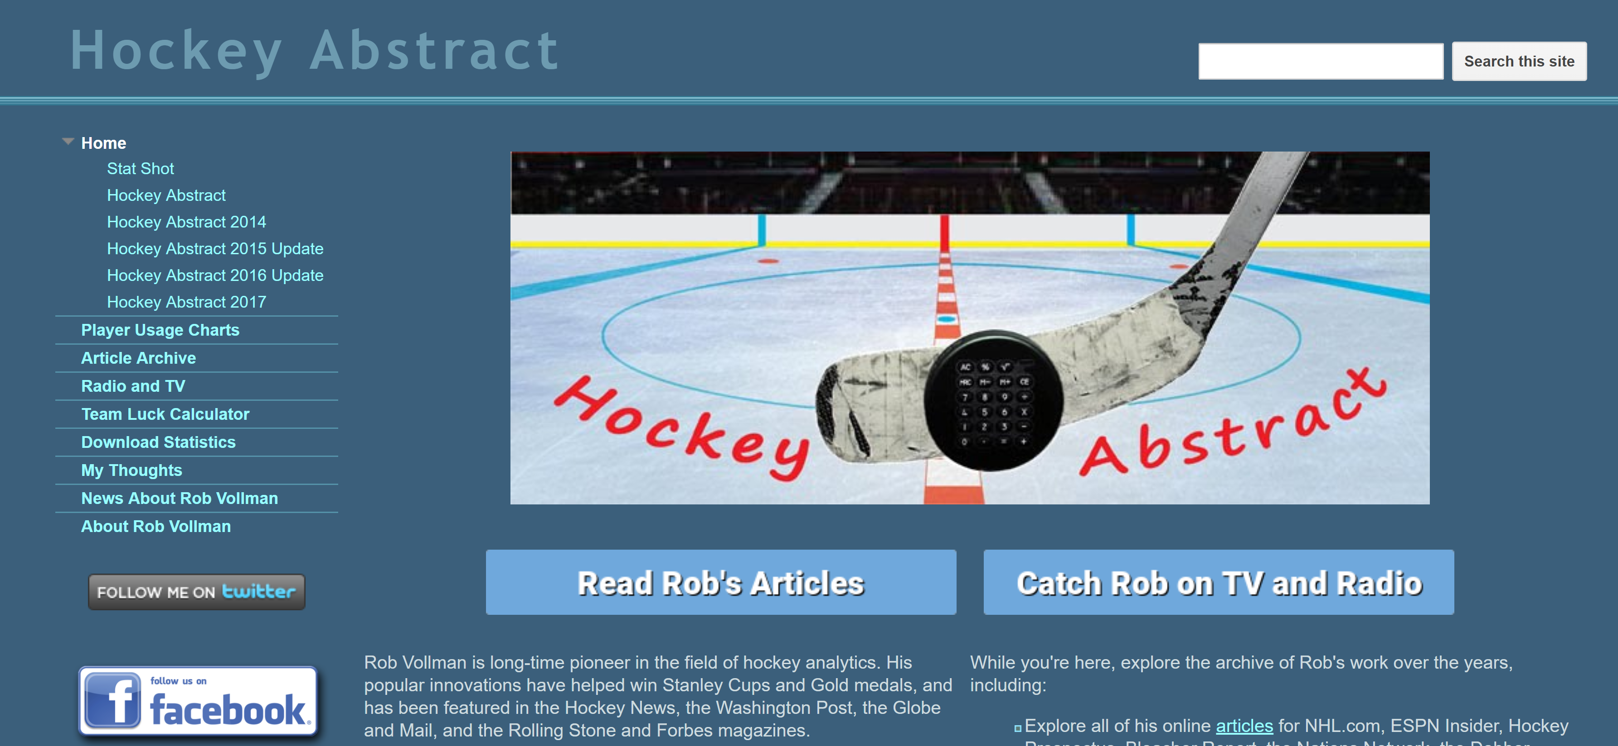
DATA COLLECTION & VALIDATION
We chose to focus on the 2016-2017 season, the last full NHL season
Data was collected from: http://www.hockeyabstract.com/
The source data was compiled from several different sources, including:
NHL.com, Corscia.com, Puckalytics.com, Hockey-reference.com, and more

Slide 14
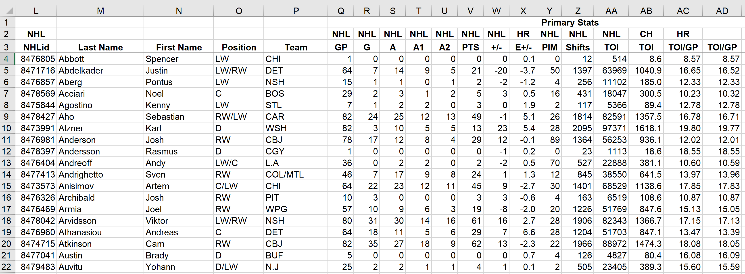
DATA COLLECTION & VALIDATION
Raw data came in Excel format
Number formats were cleaned and NULL values were removed in Excel

Slide 15
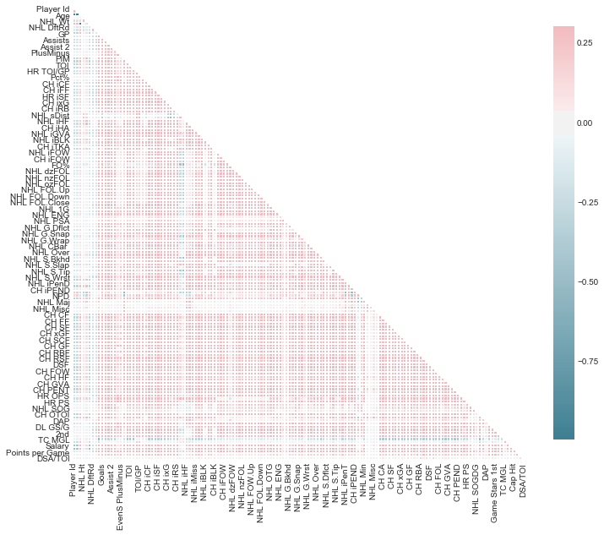
Correlation Matrix
A good way to identify potential relationships among numerical variables is to analyze their correlations
To do this, we created a correlation matrix
Unfortunately, it did not yield many strong correlations among the raw data

Slide 16
DATA COLLECTION & VALIDATION
Based on the correlation matrix, we decided that we would need to group our data into several different categories such as Nationality, Free Agent Status, Shot Type, and more
For analysis involving player salary data, the data was subset to only include Unrestricted Free Agent (UFA) players
For analysis involving player’s nationality, countries with 5 or fewer active players was grouped into an “OTH” category

Slide 17
DATA ANALYSIS

Slide 18
DATA ANALYSIS
Boxplots:
Cap Hit by Nationality
Draft Round vs. Points Per Game
Scatterplots:
Cap Hit vs. Points Per Game
Goals For vs. Goals Against by Cap Hit
Bar Charts:
Salary by Position, sorted by Division and Team
Goals, Shots and Shooting Percentage by Shot Type

Slide 19
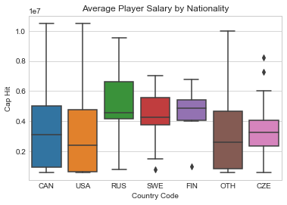
Cap Hit by Nationality
The distribution of cap hits appears very similar for Canadian and American players
The median cap hit for Russians, Finns and Swedes is noticeably higher than the cap hits
Russian players had the highest median cap hit in 2016-17, but this was heavily affected by top earners, Alex Ovechkin ($9.54M) and Evgeni Malkin ($9.5M)
Notes:
Break

Slide 20
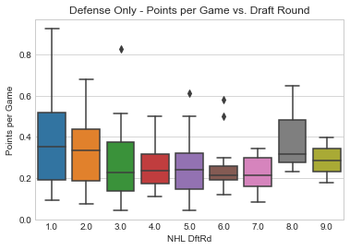
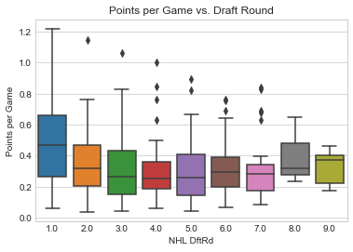
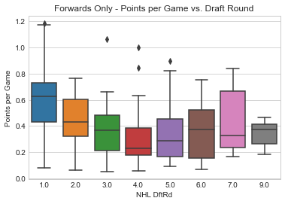
Draft Round vs. Points Per Game
Players drafted in the first round clearly had the highest PPG avg.
After the first round, there is no noticeable difference in PPG
A more linear trend in PPG is noticeable from Rounds 1 – 4 among Forwards; after Rd 4 there is no clear pattern
The PPG trend among defensemen is flatter, having no evident linear relationship with a player’s Draft Round

Slide 21
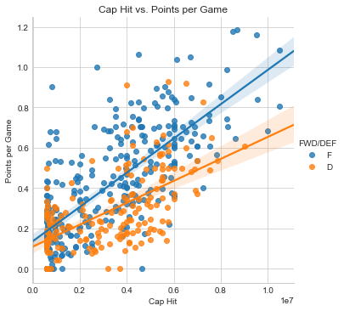
Cap Hit vs. Points per Game
There are positive linear trends between a player’s cap hit and their PPG.
As expected, forwards tend to have higher PPG averages than defensemen; this is also evident by the steeper slope of the Forward (blue) trend line
There appears to be more variability in the PPG vs. Cap Hit relationship among defensemen compared to forwards

Slide 22
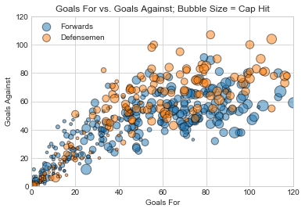
Goals For vs. Goals Against
Examining the relationship between Goals For and Goals Against can indicate how well a player is performing
Separating by Forwards vs. Defensemen, there is perhaps a slight difference in the trends, with the top D-men being on the ice for a slightly higher percentage of Goals For

Slide 23
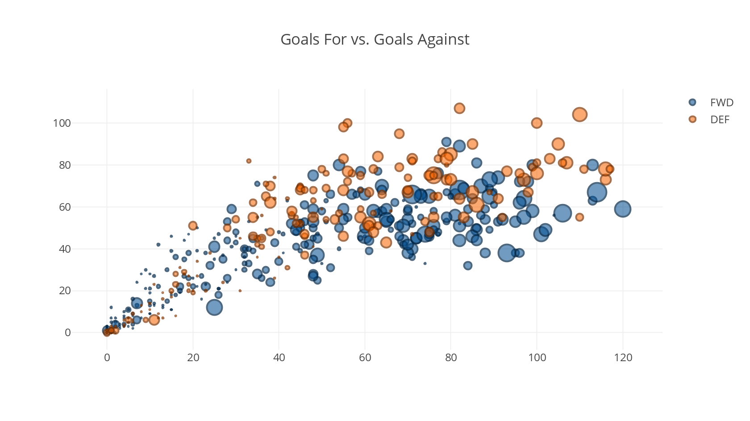
Goals For vs. Goals Against
Examining that trend on a standard scatterplot is interesting, but without labeling the dots, it’s not very helpful…
We tried using the plotly library to create an interactive chart

Slide 24
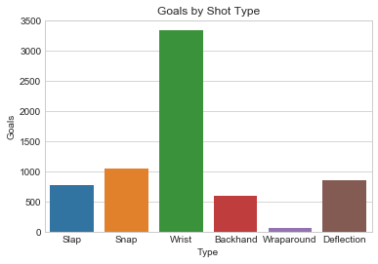
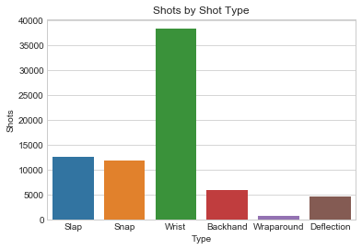
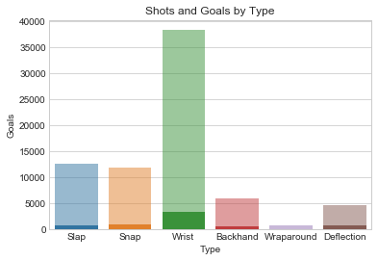
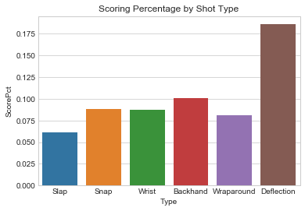
Goal & Shot Analysis
Shooting the puck is key to scoring goals, but which type of shot is the most effective?
More goals have been scored via wrist shots than any other type…
But it is also the most common type of shot taken by far
Looking at the scoring percentage, we can see that Deflections are the most efficient shot.

Slide 25
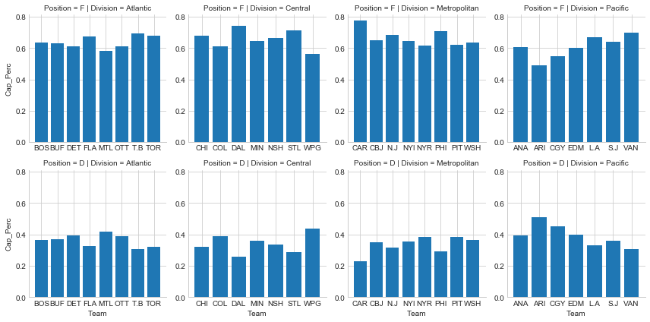
Salary by Position
Notes:
Using a Facet Wrap, we can quickly see how teams allocate their salary caps between Forwards and Defensemen.

